Slide 1
React Redux
Fullstack

Slide 2
Agenda
Introduction
Benefits of Redux
Core Concepts of Redux
Core Principles of Redux
Hands-on example on Single Reducer
Hands-on example on Combined Reducers

Slide 3
Introduction
Redux is an open-source JavaScript library is a predictable state container for the JS apps.
Redux provides a centralized location for managing application state, making it easier to reason about how data is flowing through an application.
Redux can be used with any JavaScript application, but it is often used in conjunction with other libraries and frameworks like React.
Redux can be used in a variety of application architectures, including server-side rendering, progressive web apps, and native mobile apps.

Slide 4
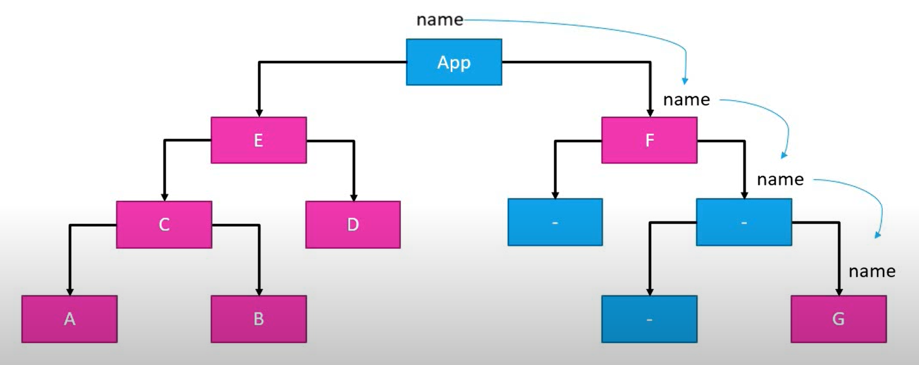
Introduction

Slide 5
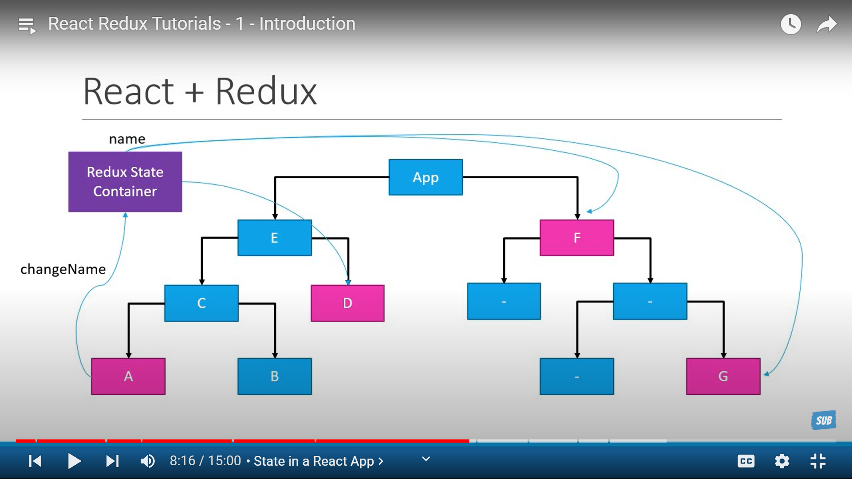
Introduction

Slide 6
Benefits of Redux
Centralized state management: Redux provides a centralized location for managing application state, making it easier to reason about how data is flowing through an application.
Predictable state updates: Redux follows a unidirectional data flow model, which makes it easier to predict how state will change in response to user actions or other events.
Time-travel debugging: Redux makes it easier to implement features like time-travel debugging, where a developer can step backwards and forwards through the state of an application to diagnose problems.
Developer experience: Redux can simplify the development experience by providing a clear separation of concerns between application logic and state management.
Scalability: Redux can scale to manage complex state management requirements in large applications, making it a good choice for enterprise-level applications.

Slide 7
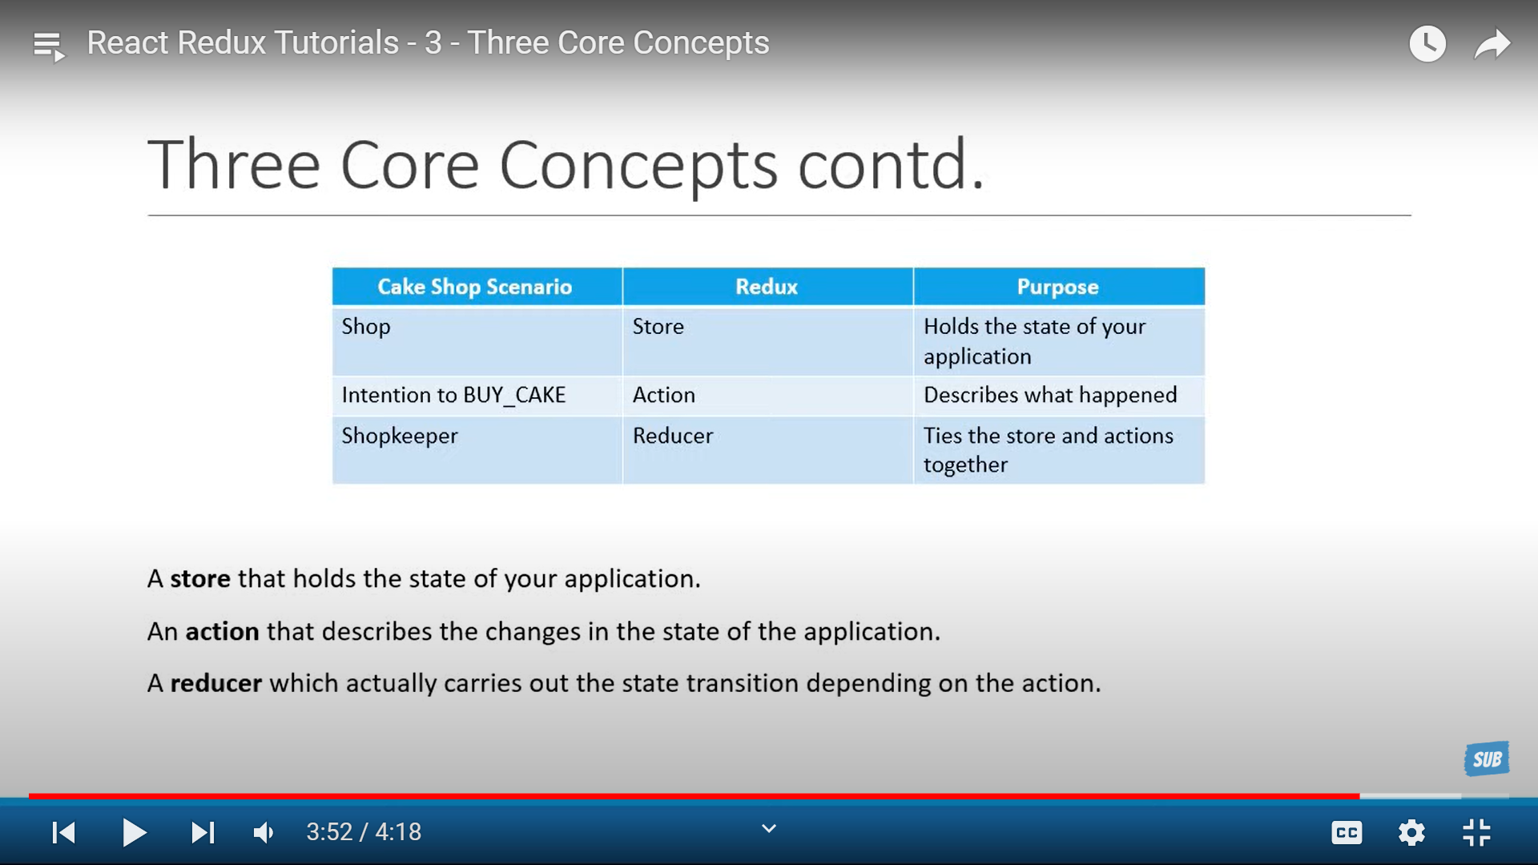
Three Core Concepts of Redux
Store : A store holds the state of the application.
Action : An action describers the changes in the state of the application.
Reducer : A reducer carries out the state transition depending upon the action.

Slide 8
Three Core Principles of Redux
The state of our whole application is stored in an object tree within a single store. In our cake shop example, noOfCakes is a state.
The only way to change the state is by dispatching an action, an object describing what happened. We are not allowed to directly update the state. In our cake shop example, BUY_CAKE is an action.
To specify how the state tree is transformed, we need to write pure reducers. Pure reducers are basically a function that takes the previous state and action as parameters and returns the new state. In the cake shop example, the reducer is the shopkeeper.

Slide 9
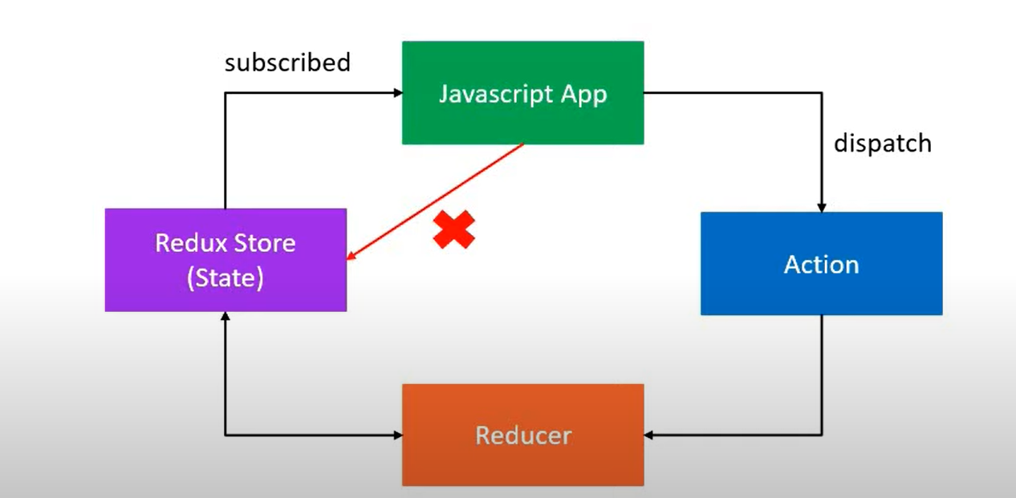
Three Core Principles of Redux

Slide 10
Agenda
Middleware Overview
Hands-on with Redux logger middleware
Overview of Redux thunk
Hands-on with Redux thunk middleware
Hands-on with React with Redux

Slide 11
Middleware
It's a suggested way to extend Redux with custom functionality.
It sits between the dispatch function and the reducers. When an action is dispatched, it passes through each middleware function before reaching the reducers.
We can use middleware for logging, crash-reporting, performing asynchronous tasks etc.
Popular middleware libraries for Redux include redux-logger, redux-thunk, redux-saga, and redux-observable, each providing their own unique features and benefits.

Slide 12
Redux Thunk
redux-thunk is a popular middleware library for Redux that allows us to write asynchronous logic that interacts with the Redux store.
It allows you to write action creators that return functions instead of plain objects.
These functions can perform asynchronous operations, such as fetching data from an API, and then dispatching normal action objects based on the result.

Slide 13
Agenda
Redux hooks
Redux devTools
Generator Function
Redux Saga Overview
Hands-on with Redux saga

Slide 14
Redux Hooks
useSelector: This hook allows us to select a slice of the Redux store state and subscribe to updates. It takes a function that returns the desired slice of the state, and returns that slice whenever it changes.
useDispatch: This hook returns the dispatch function of the Redux store, which we can use to dispatch actions. It's typically used to trigger state changes in response to user interactions or other events.
useStore: This hook returns the Redux store object, which we can use to interact with the store directly.

Slide 15
Generator Functions
A generator function is a special type of function in JavaScript that allows you to pause and resume its execution at arbitrary points in the function code. When a generator function is called, it returns a generator object which can be used to control its execution.
The execution of a generator function can be paused using the yield keyword. When a yield statement is encountered, the function execution is paused, and the value of the yield statement is returned to the caller. The next time the generator is resumed, execution continues from where it left off.
function* myGenerator() {
yield 1;
yield 2;
yield 3;
}
const generator = myGenerator();
console.log(generator.next()); // { value: 1, done: false }
console.log(generator.next()); // { value: 2, done: false }
console.log(generator.next()); // { value: 3, done: false }
console.log(generator.next()); // { value: undefined, done: true }
Generator functions are commonly used in libraries such as redux-saga to implement complex asynchronous flows in a readable and manageable way.

Slide 16
Generator Functions
yield: This is a keyword used in a generator function to pause the execution of the function and return a value to the caller. When the function is resumed, it picks up from where it left off.
takeLatest: This is a function that listens for a specific action and automatically cancels any previous requests that haven't finished yet. It only returns the latest request, which is the one that will be processed.
all: This is a function that takes an array of sagas and runs them in parallel. It's useful when we have multiple sagas that need to be run concurrently.
put: This is a function that dispatches an action to the Redux store. It's typically used to trigger a state change in response to a successful asynchronous operation.

Slide 17
Redux Saga
redux-saga is a middleware that uses a generator functions to handle side effects in a Redux application.
The generator function, called a saga, listens for dispatched actions and can perform asynchronous operations using the yield keyword.
Sagas can also intercept actions, cancel ongoing operations, and dispatch new actions in response to external events.
Sagas are written using a declarative syntax, making it easier to reason about complex asynchronous flows in your application.

Slide 18
Agenda
Redux Thunk vs Redux Saga
Hands-on with Redux ToolKit

Slide 19
Redux Thunk vs Redux Saga
Programming model: redux-thunk uses a simpler programming model based on synchronous actions that can return functions. In contrast, redux-saga uses a more complex programming model based on declarative sagas that are written as generator functions using special effects.
Control flow: With redux-thunk, control flow is determined by the order in which actions are dispatched. With redux-saga, control flow is explicitly managed by the sagas, which can take control of the flow of actions and perform advanced logic, such as race conditions and retries.
Use-case: For simple applications with straightforward asynchronous logic, redux-thunk may be a good choice. For more complex applications with advanced asynchronous flows, redux-saga may provide more power and flexibility.
Learning curve: redux-thunk has a lower learning curve than redux-saga because it is based on a simpler programming model. redux-saga requires more advanced knowledge of JavaScript, generators, and special effects.

Slide 20
Thank you

